Slide 1
UNDERSTANDING .NET ASSEMBLES

Slide 2
Problems with Classic COM Binaries,
An Overview of .NET Assembly,
Building a Simple File Test Assembly,
A C#. Client Application,
A Visual Basic .NET Client Application,

Slide 3
Cross Language Inheritance,
Exploring the CarLibrary’s, Manifest,
Exploring the CarLibrary’s Types,
Building the Multifile Assembly,
Using Assembly,
Understanding Private Assemblies,

Slide 4
Probing for Private Assemblies (The Basics),
Private A Assemblies XML Configurations Files,
Probing for Private Assemblies ( The Details),
Understanding Shared Assembly,

Slide 5
Understanding Shared Names,
Building a Shared Assembly,
Understanding Delay Signing,
Installing/Removing Shared Assembly,
Using a Shared Assembly.

Slide 6
An Overview of .NET Assemblies
What is assembly?
Assembly is a logical collection of smallest unit in .NET Framework.
Microsoft .Net Assembly is a logical unit of code, that contains code which the Common Language Runtime (CLR) executes.
An assembly is a file that is automatically generated by the compiler upon successful compilation of every .NET application.

Slide 7
Assembly can be either a Dynamic Link Library(DLL) or an executable file(EXE).
It is generated only once for an application and upon each subsequent compilation the assembly gets updated.
The entire process will run in the background of your application; there is no need for you to learn deeply about assemblies.

Slide 8
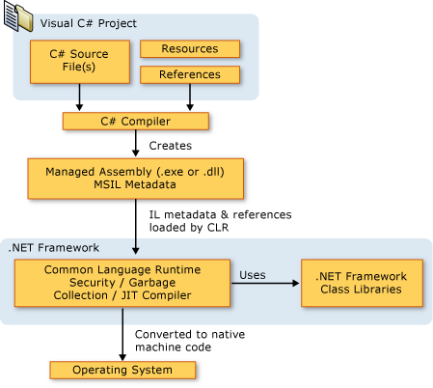

Slide 9
Types of assemblies
Single File Assemblies
Multifile Assemblies
Single File Assemblies:
A single-file assembly consists of a single .exe or .dll file.
Multifile Assemblies:
A multifile assembly is an assembly that can include multiple file, but it should contain atleast one .dll or .exe file.

Slide 10
What is Private Assembly?
When you deploy an assembly which can be use by single application, than this assembly is called a private assembly.
Private assemblies can be used by only one application they are deployed with.
Private assemblies are deployed in the directory where the main application is installed.

Slide 11
What is Shared Assembly?
When you deploy an assembly which can be used by several application, than this assembly is called shared assembly.
Shared assemblies are stored in a special folder called Global Assembly Cache (GAC), which is accessible by all applications.
Shared assemblies must have a strong name. A strong name consists of an assembly name, a version number, a culture, a public key and an optional digital signature.
GAC is capable of maintaining multiple copies of an assembly with the same name but different versions.

Slide 12
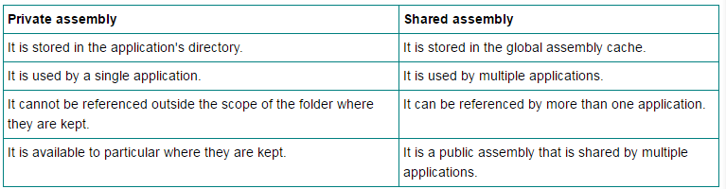

Slide 13
Assembly contains following information:
a) Assembly Manifest - The Metadata that describes the assembly and its contents
b) Type Metadata - Defines all types, their properties and methods.
c) MSIL - Microsoft intermediate language
d) A set of Resources - All other resources like icons, images etc.

Slide 14
.Net Assembly Manifest
An Assembly Manifest is a file that containing Metadata about .NET Assemblies.
Assembly Manifest contains a collection of data.
It describes how the elements in the assembly relate to each other.
It describes the relationship and dependencies of the components in the Assembly, versioning information, scope information and the security permissions required by the Assembly.

Slide 15
An assembly manifest contains the following information: - Identity of the assembly - Types and resources - Files - Security permissions

Slide 16
Assembly Manifest can be stored in a file called Portable Executable (PE) file with Microsoft Intermediate Language (MSIL) code.
You can add or change some information in the Assembly Manifest by using assembly attributes in your code.
The Assembly Manifest can be stored in either a PE file (an .exe or .dll) with Microsoft Intermediate Language (MSIL) code or
in a standalone PE file that contains only assembly manifest information.
Using ILDasm, you can view the manifest information for any managed DLL.

Slide 17
Views of an Assembly
Physical View Assembly
Logical View Assembly
When you build an assembly, you are interested in the physical view.
In this case, the assembly can be understand as some number of files that contain your custom types and resources.

Slide 18
When you build an assembly, you are interested in the logical view.
In this case, you can understand an assembly as a versioned collection of public types that you can use in your current application.

Slide 19
Assemblies support Code Reuse
Assemblies contain code that is executed by the .NET runtime.
The types and resources contained within an assembly can be shared and reused by multiple applications.

Slide 20
it is not only possible to reuse types between languages, but to extend types across languages as well.
In classic COM, developers were unable to derive COM object A from COM object B (even if both types were developed in the same language).
In short, classic COM did not support classical inheritance (the 'is-a' relationship).

Slide 21
Assemblies Establish a Type Boundary
Assemblies are used to define a boundary for the types (and resources) they contain.
In .NET, the identity of a given type is defined by the assembly in which it resides.
Therefore, if two assemblies each define an identically named type (class, structure, or whatnot) they are considered independent entities in the .NET universe.

Slide 22
Assemblies Are Versionable and Self-Describing Entities
To ensure binary compatibility between MyComServer.dll version 1.0 and MyComServer.dll version 2.4, the programmer must use basic common sense to ensure interface definitions remained unaltered or run the risk of breaking client code.
While a healthy dose of versioning common sense also comes in handy under the .NET universe, the problem with the COM versioning scheme is that these programmer-defined techniques are not enforced by the runtime.

Slide 23
Each assembly has a version identifier that applies to all types and all resources contained within each module of the assembly.
Using a version identifier the runtime is able to ensure that the correct assembly is loaded on behalf of the calling client, using a well defined versioning policy

Slide 24
An assembly's version identifier is composed of two basic pieces:
A friendly text string (termed the informational version)
A numerical identifier (termed the compatibility version).

Slide 25
create a new assembly with an informational string of 'MyInterestingTypes.'
This same assembly would also define a compatibility number, such as 1.0.70.3.
The compatibility version number always takes the same general format (four numbers separated by periods).
The first and second numbers identify the major and minor version of the assembly (1.0 in this case).
The third value (70) marks the build number, followed by the current revision number (3).
The .NET runtime makes use of an assembly's version to ensure the correct binary is loaded on behalf of the client

Slide 26
Assemblies Enable Side-by-Side Execution
The biggest advantage of the .NET assembly is the ability of multiple versions of the same assembly to be loaded (and understood) by the runtime.
it is possible to install and load multiple versions of the same assembly on a single machine. In this way, clients are isolated(cut-off) from other incompatible versions of the same assembly.

Slide 27
Assemblies Define a Security Context
An assembly may also contain security information.
Example: if Assembly A wishes to use a class contained within Assembly B, Assembly B is the entity that chooses to provide access (or not).
The security constraints defined by an assembly are explicitly listed within its manifest.
A treatment of .NET security measures is outside the mission of this text, simply be aware that access to an assembly's contents is verified using assembly metadata.

Slide 28
Cross-Language Inheritance
Cross language inheritance in .NET. Integrating VB.NET and C#.NET in an easy way.
Merging C#.NET and VB.NET in one file.
Developers had a problem of moving the COM components written in one language to another.
They couldn’t make use of a C++ class in Visual Basic nor they could inherit them.

Slide 29
Understanding Shared Assemblies
When you deploy an assembly which can be used by several application, than this assembly is called shared assembly.
shared assemblies can be used by several clients on a single machine.
Shared assemblies are stored in a special folder called Global Assembly Cache (GAC), which is accessible by all applications.

Slide 30
A shared assembly is typically not deployed within the same directory as the application making use of it.
shared assemblies are installed or stored in a special folder called Global Assembly Cache(GAC).
The GAC itself is located under the <drive.: \ WinNT \ Assembly subdirectory.>

Slide 31
Another major difference between the COM and .NET architectures is:
In COM, shared applications can reside anywhere on a given machine, provided they are properly registered.
.NET, shared assemblies are typically placed into a centralized well-known location (the GAC).

Slide 32
Understanding Shared (Strong) Names
create an assembly that can be used by numerous applications on a given machine.
First step is to create a unique shared name for the assembly.
A shared name contains the following information:
A friendly string name and optional culture information
A version identifier.
A public/private key pair.
A digital signature.

Slide 33
The composition of a shared name is based on standard public key cryptography.
When you create a shared assembly, you must generate a public/private key pair (that you do momentarily).
The key pair is included in the build cycle using a .NET aware compiler, which in turn lists a token of the public key in the assembly's manifest.

